Slide 1
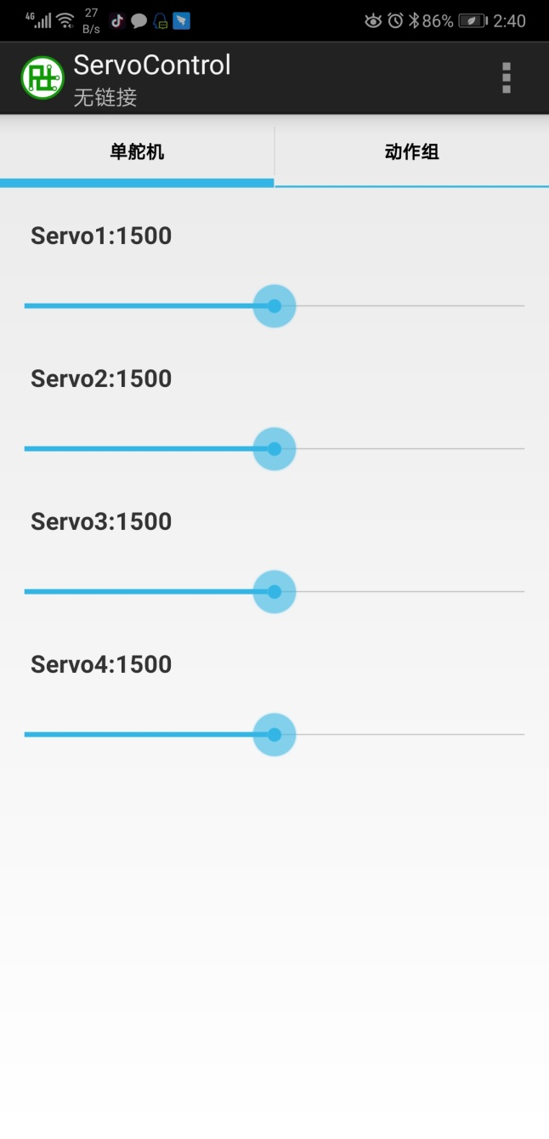
1.open app，like that

Slide 2
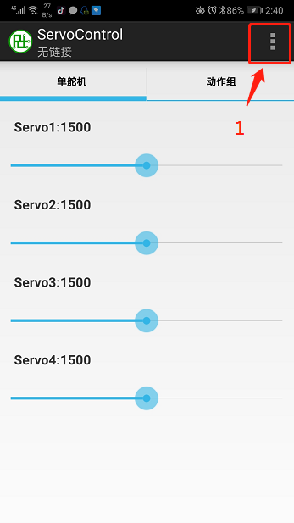
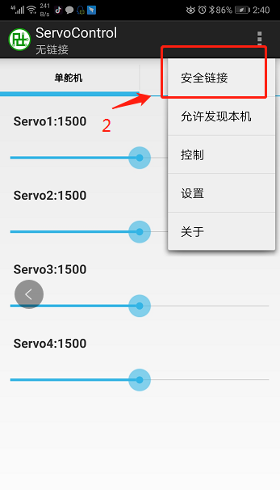
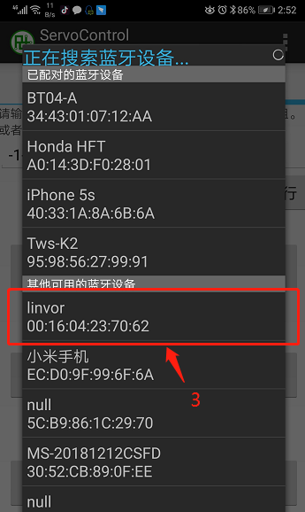
2.how to connect Bluetooth module

Slide 3
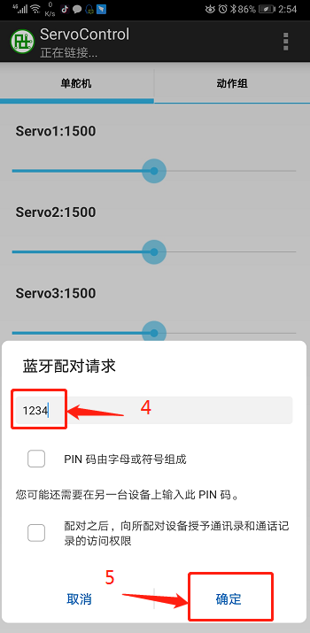
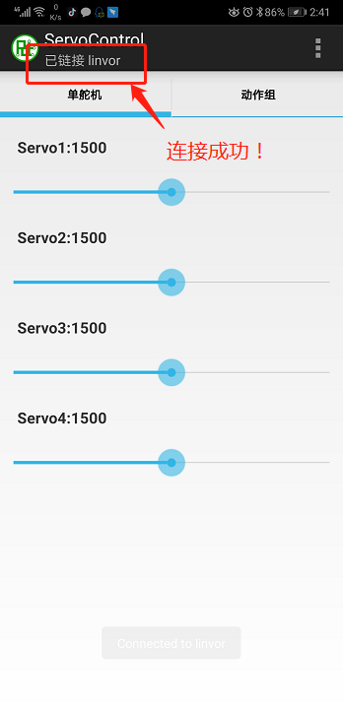
2. connect Bluetooth module

Slide 4
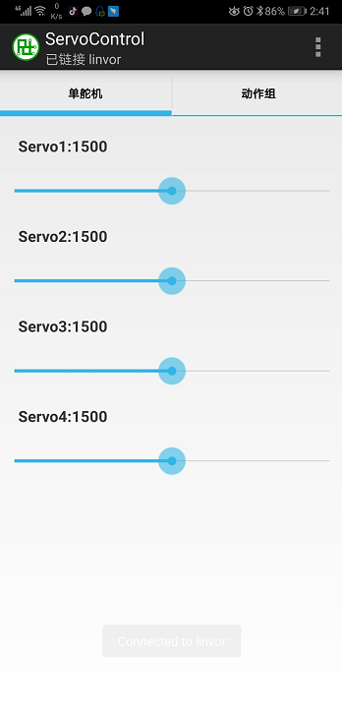
3.Use-servo control
different servos:
Servo1 connect A0 servo
Servo2 connect A1 servo
Servo3 connect A2 servo
Servo4 connect A3 servo
Value after rudder:
Range 500-2500
Use:
the value of the servo is changed by pulling.
The servo will rotate and act differently.

Slide 5
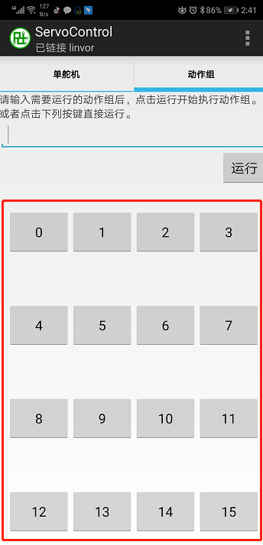
3.Use - Action Save
Use:
1. As shown in the figure, there are 16 key saving actions.
2. Click the corresponding button to save the action.
For example:
After the robot arm action is set, click the "0" button.
Action will be saved!
Note: Even after power failure,
recorded actions will not disappear!

Slide 6
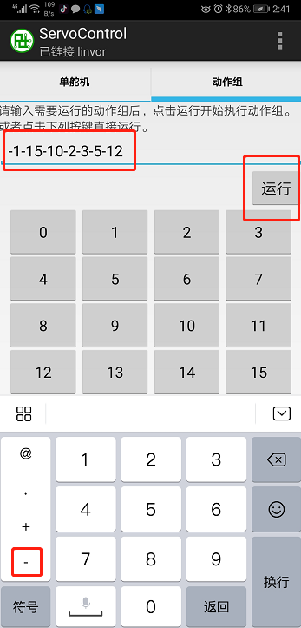
3.Use - Continuous Action
Use:
1. Input action number, as shown in Figure
- 1-15-10-2-3-5-12
2. Click to run and the arm starts to move.
Explain:
Robot arm action: action 1, action 15, action 10,
Action 2, Action 3, Action 5, Action 12, End
Note: Symbols should be used before each action number: "-" minus sign.

